Slide 1
CAREER MANAGEMENT
MGT4303

Slide 2
Agenda
Brand Called You Assignment
Discover and Declare Process
Know Yourself Assignment
Homework

Slide 3
Close Laptops
Silence and Put Away Phones

Slide 4
Discover and Declare Process
Keywords
Mindmap
30 Sec. Commercial
In-Class Today
Homework
Next Class + Homework

Slide 5
Group Activity to Find Your Keywords
Materials:
  Paper and pen or pencil if you prefer written notes.
  Laptop for research and electronic notes.
  Career worksheet 2-3

Slide 6
Group Activity to Find Your Keywords
Groups of 3-4 complete 7 question sheets
Values
Personality
Passions
Strengths
Achievements
Target
Opinions of Others

Slide 7
Group Activity to Find Your Keywords
Instructions for each sheet:
  Work together to answer group questions
  Answer individual questions – you can help each other!
  DO NOT move on until EVERYONE is finished.
  Bring your question sheet to the front and get a new one.
  Take your own notes – you will need to submit them
  Include titles for each question sheet and number your questions

Slide 8

Mind Mapping Time
A mind map is a diagram arranged around a central keyword or idea.
Can be hand drawn or done using electronic tools such as drawing software or
  www.mindmeister.com
  www.mindomo.com
How to Mind Map by Think Buzan.com
How to Mind Map by MacGrercy Consultant

Slide 9
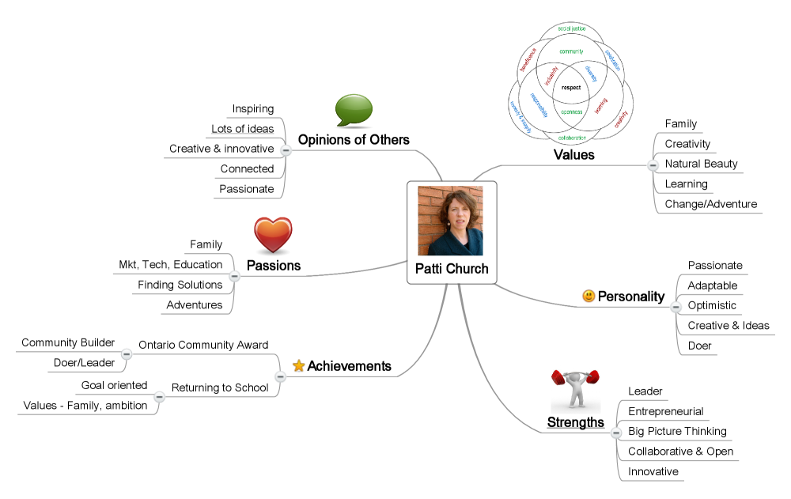
Use the keywords you have discovered to create your mindmap.
Target
Education sector
Full time
Ottawa
Notes:
“Your mind map will end up having seven different branches and several sub branches. You may use colours and images, if you prefer. It’s up to you have you develop your mind map.”

Slide 10
Complete Your Mind Map – Find the Themes
Highlight the characteristics that keep reoccurring.
You will find that there was some repetition as you moved through the process of self-analysis.
Did creativity show up as a value of yours then reveal itself as a strength? Did your colleagues also share the same opinion of you?
If a characteristic seems to be following you, then embrace it and use it to uniquely position yourself.

Slide 11
Searching for Themes
Highlight 5 key themes/words on your mindmap.
Target
Education sector
Full time
Ottawa

Slide 12
Know Yourself Assignment 5%
Submit the following by the beginning of next class.
  Your answers to group and individual questions from the in-class keyword activity
  Your mindmap with 5 key themes/words highlighted on it
Submit electronically through the assignment on Brightspace or on paper.

Slide 13
Homework
Read Chapter 2, Outcome 2: Develop your Brand Statement and 30 Second Commercial
Complete Know Yourself Assignment 5%

